Slide 1
DATAVIZ 300 Week 5: Communicating to your User + Designing Impactful Visualizations

Slide 2
Course Topics (and Assignments)
May 3:
Week 4 – Designing Impactful Visualizations
User-Centered Design
Leveraging a story structure for visualization presentation.
Final Project Milestone: You should have an understanding about the nuances of your data set and be able to identify the measures and dimensions of your final visualization.

Slide 3
Course Topics (and Assignments)
May 10:
Week 5 – Communicating to Your User
Visualization best practices
Fit & Finish Tips and Tricks
Required Assignment #2: Submit your first pass of your Visualization to the discussion board for feedback from your instructor and peers. Complete by 5/13.

Slide 4
Today’s Lesson: Story Structure for Visualizations Hands on Exercises Chart Types Advanced Chart Types Fit & Finish Homework Parameters (if there is time)

Slide 5
If history were taught in the form of stories, it would never be forgotten. – Rudyard Kipling
“
”

Slide 6
The most powerful person in the world is the storyteller. The storyteller sets the vision, values and agenda of an entire generation that is to come. – Steve Jobs
“
”
Notes:
That is a really powerful quote. We’re not trying to change an entire generation. Our goals here are a little smaller. We’re just trying to convince our team, department, boss that it is important to take action from the insights we have assembled.

Slide 7
Stories are just data with a soul. – Dr. Brene Brown
“
”
Notes:
In order for our message to resonate with our audience. To be able to look them in the eye and they say I see where you are coming from, I am with you. Let’s take action on it, it’s a really important thing.

Slide 8

Notes:
Storytelling has been an effective way of transmitting information – and data – for thousands of years.
But why stories?

Slide 9

Notes:
Well, stories work because they get our attention. We tell stories because people pay attention to them. And so why not tell a story to get people to pay attention to your data and the insights you derive from them?

Slide 10

Notes:
Because our brains are hard wired to hear and respond to stories, the information we learn in story form tends to stick. We remember things we learn from stories, more easily than we remember facts that are presented independently.

Slide 11
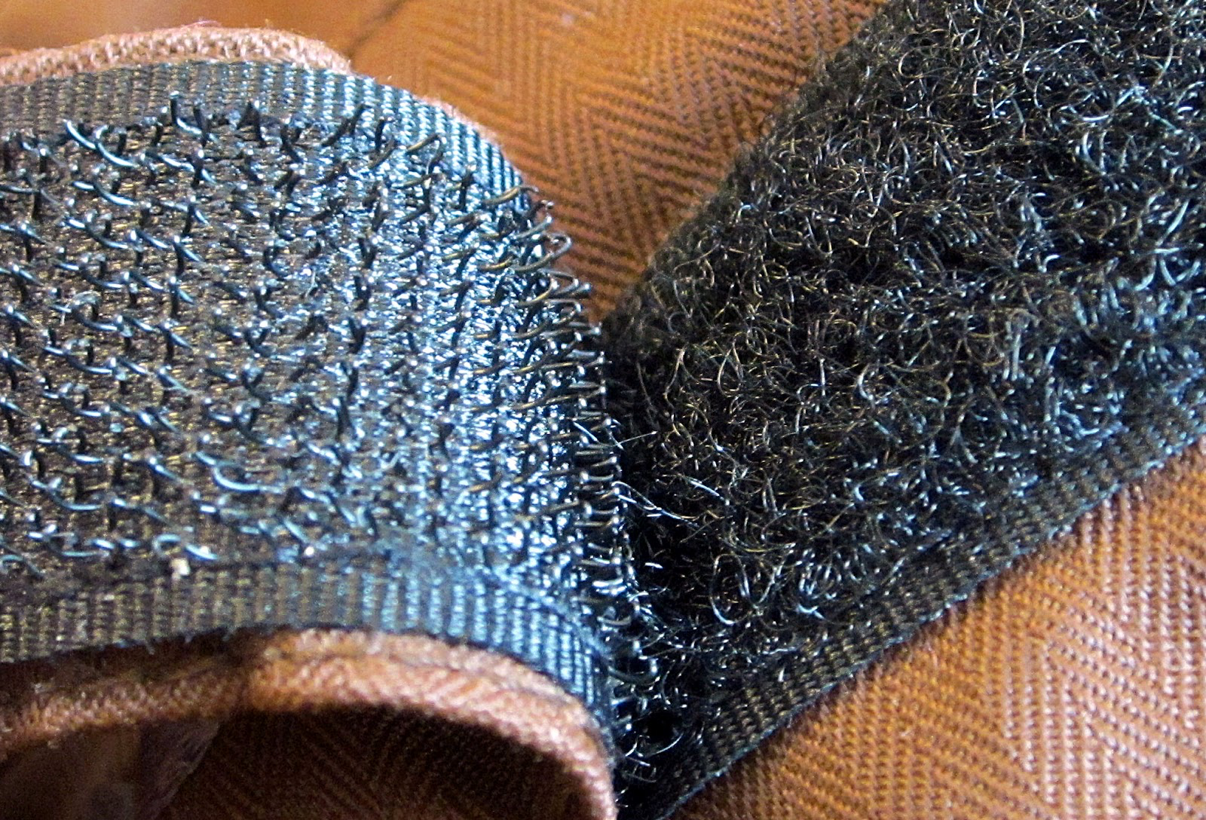
Notes:
And the way memory works is a little like velcro -- where one memory sticks to another, and another, so that the more information you have to associate, the more you remember and the more you respond. Stories are full of these connective tissues, or hooks, and that is what makes them so powerful.

Slide 12
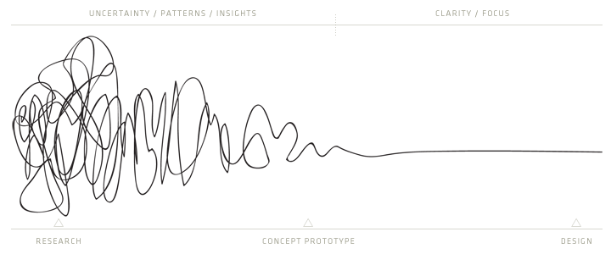
The Process of Design Squiggle by Damien Newman, http://v2.centralstory.com/about/squiggle/`

Slide 14
Data Visualisation Guided Analytics Known unknowns
Visual exploration Unguided Analytics
Freeform analytics
Unknown unknowns

Slide 15
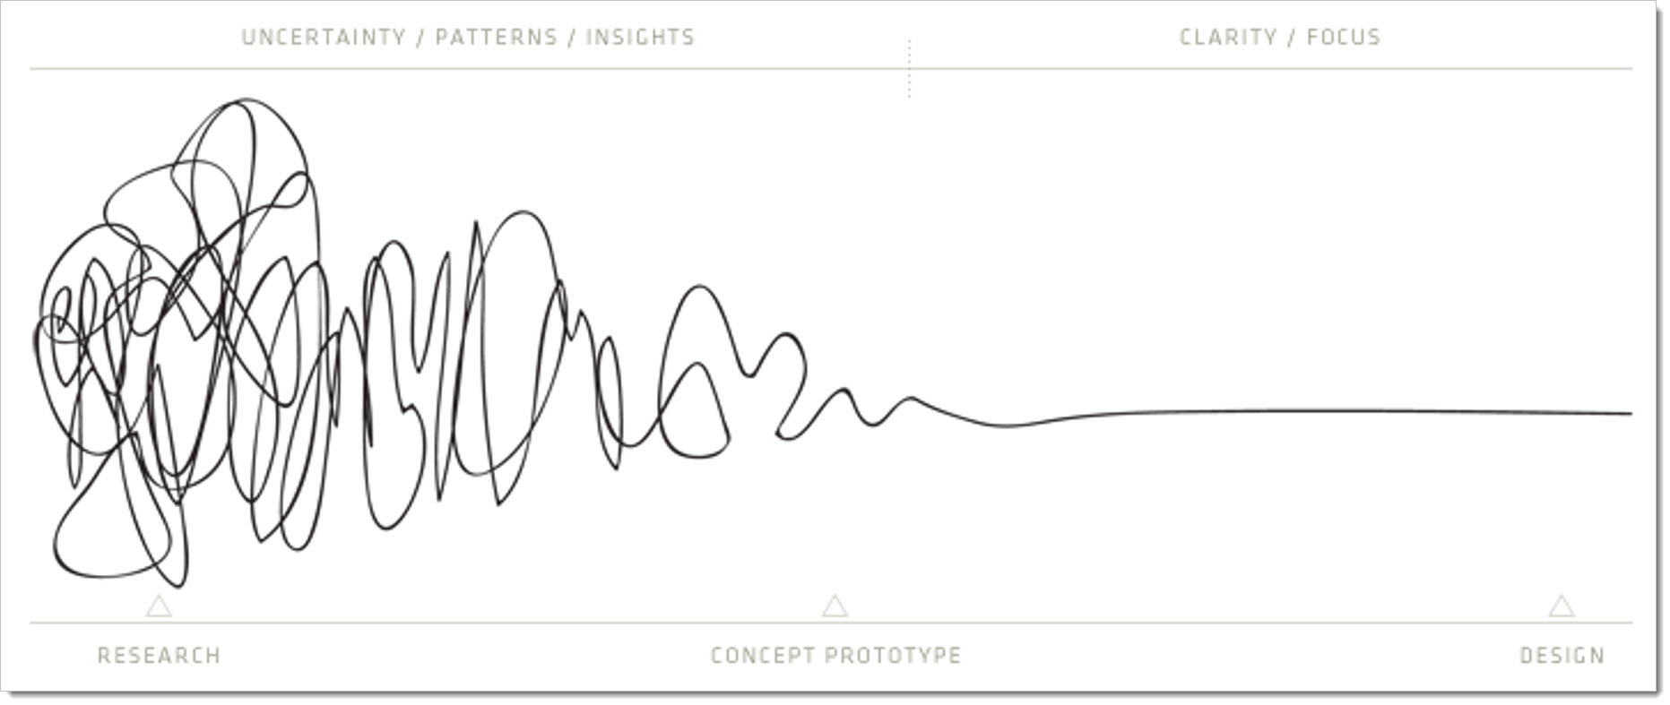

Slide 16


Telling Stories with Data
Notes:
In contemporary times, we see the popularity of telling stories with data – with clear narratives, and navigational aides – in journalism and the media. These are examples from the new york times, bloomberg, vancouver sun and other media outlets. And these are not just cases where the data is part of the story; the data is the story, and the creators build an interactive narrative with the data, right on the page.

Slide 17

Telling Stories with Data

Slide 18
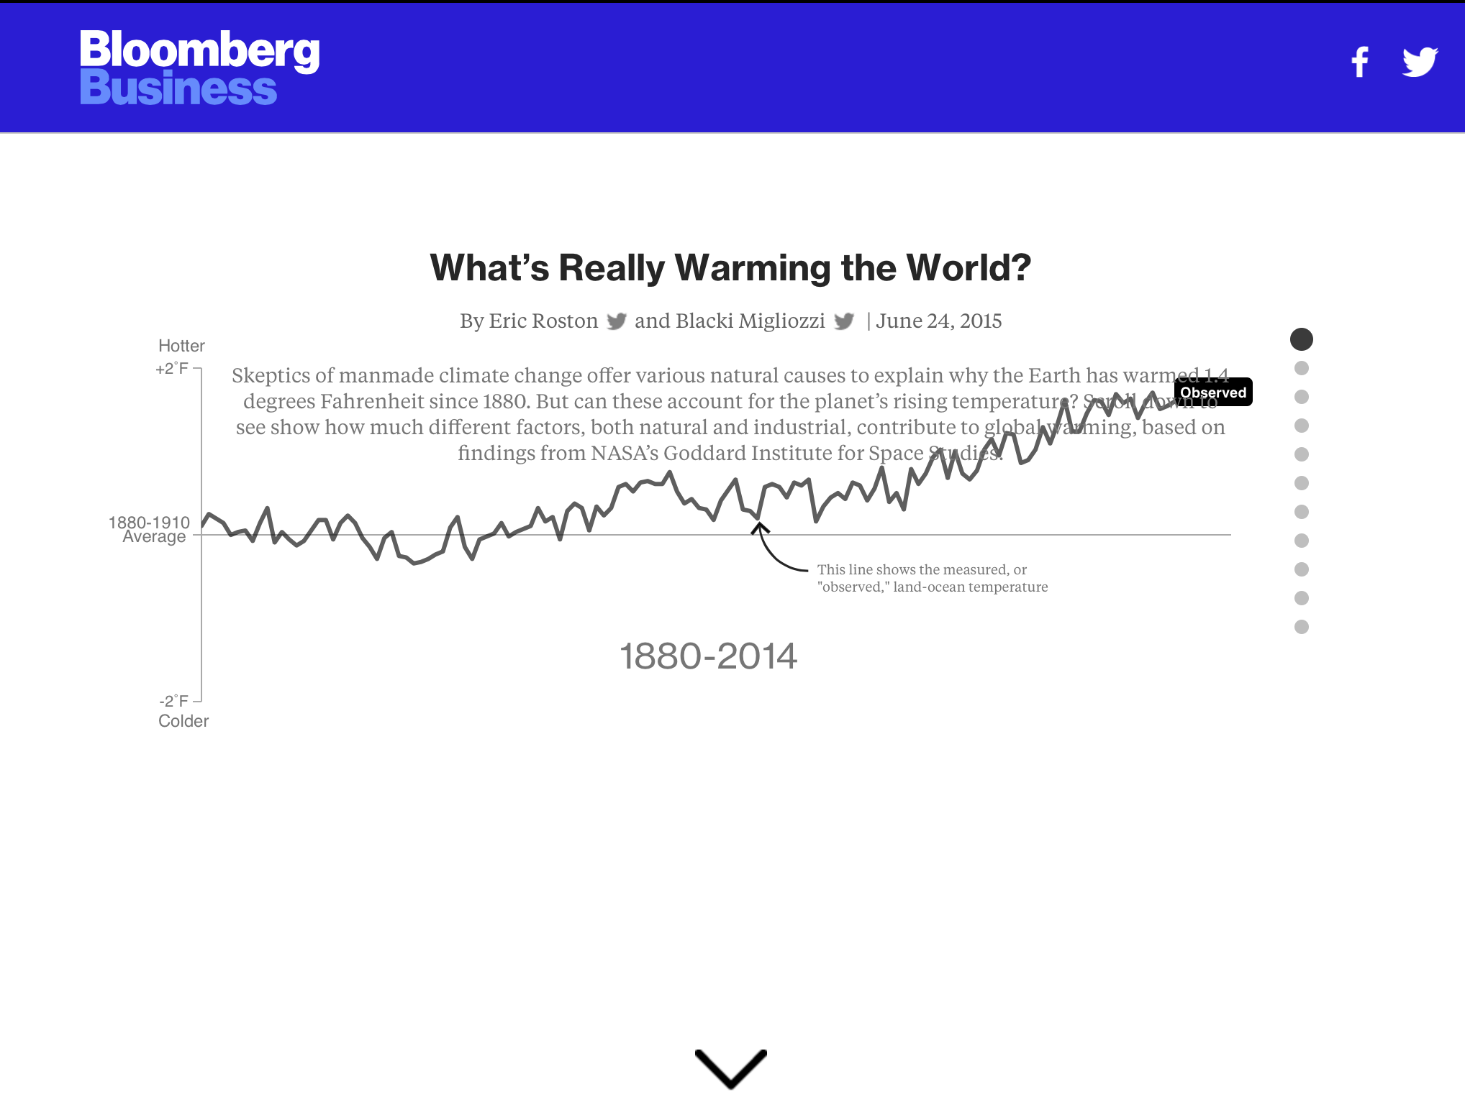
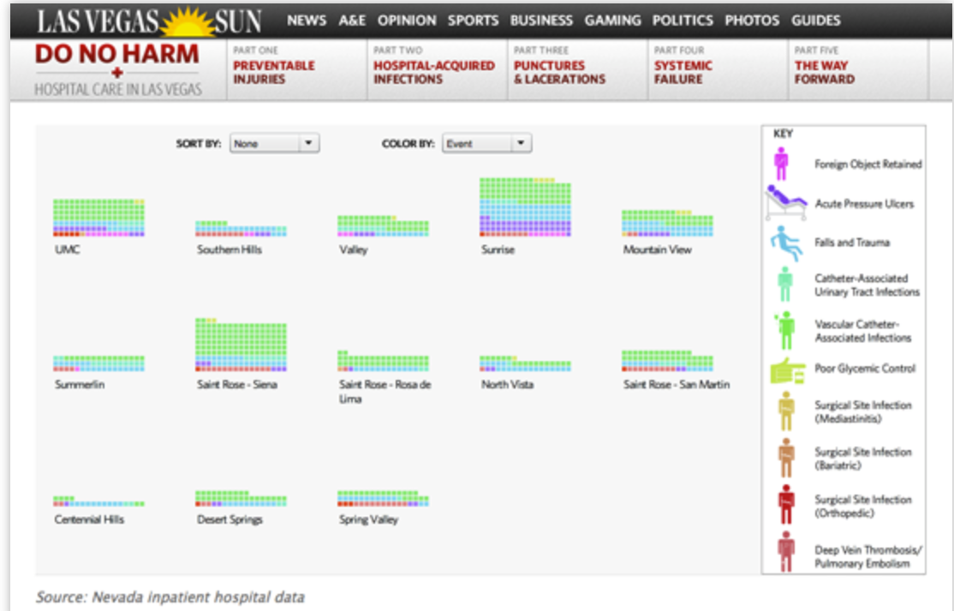
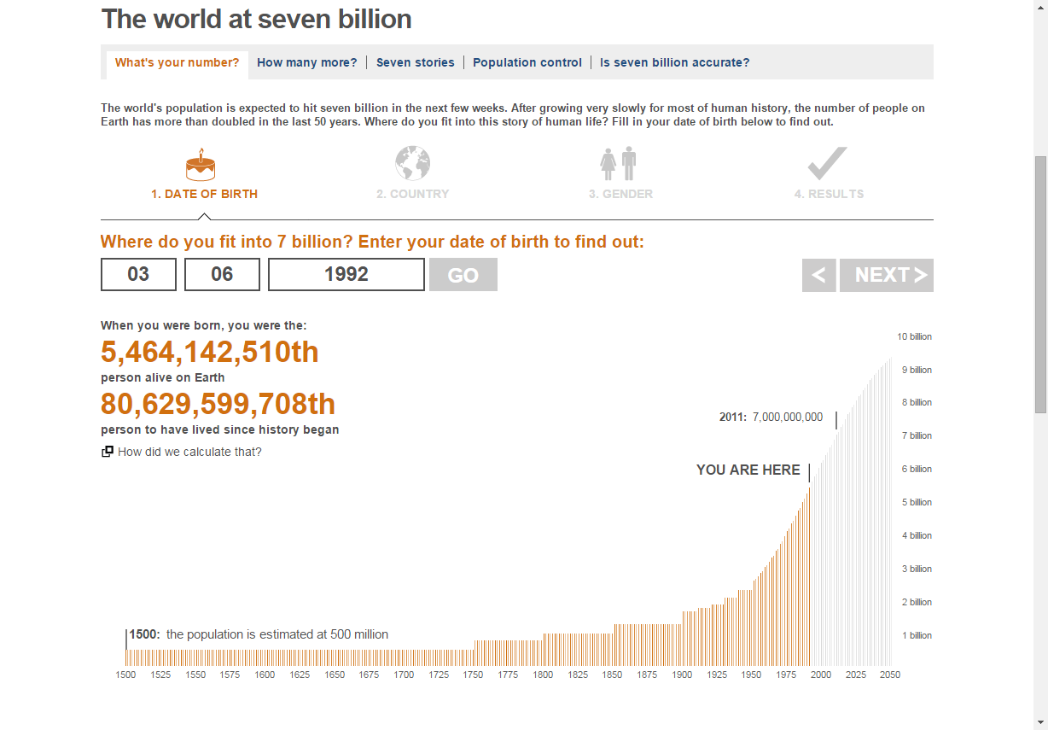
Telling Stories with Data
Notes:
In contemporary times, we see the popularity of telling stories with data – with clear narratives, and navigational aides – in many examples from leading media outlets. These are examples from the new york times, bloombeg business news, and the las vegas sun.

Slide 19
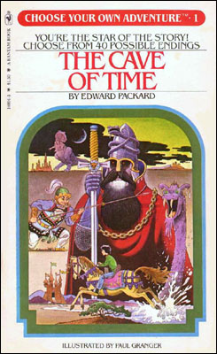


Can you only tell Stories in StoryPoints?
Notes:
Poem Visualization
“Who wants a panckar,
Wee and piping hot? Good little Grace looks up and says,
“I’ll take the one on top.”
Who else wants a pancake,
Fresh off the griddle?
Terrible Theresa smiles and says,
“I’ll take the one in the middle.”
Dashboarding is Choose Your Own Adventure
StoryPoints is A Chapter Book

Slide 20
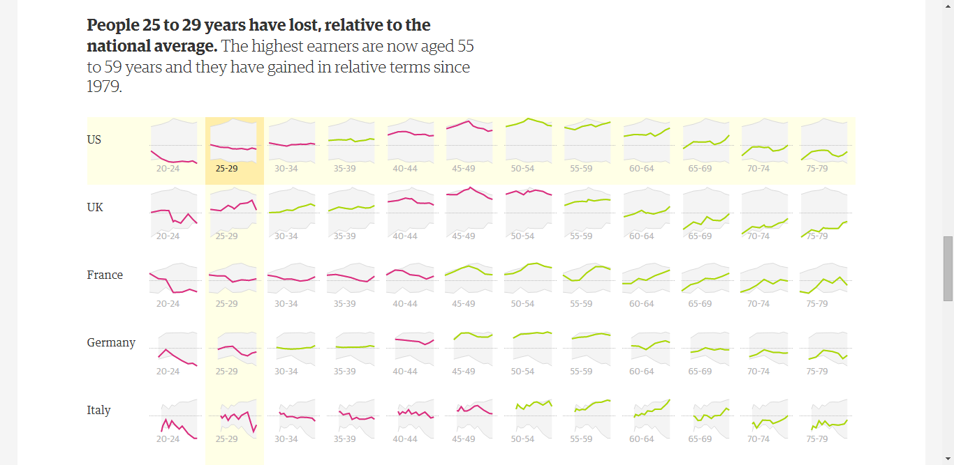

Telling Stories with Data
Notes:
http://www.theguardian.com/world/ng-interactive/2016/mar/07/whos-winning-find-out-how-your-income-compares-with-every-other-generation

Slide 21
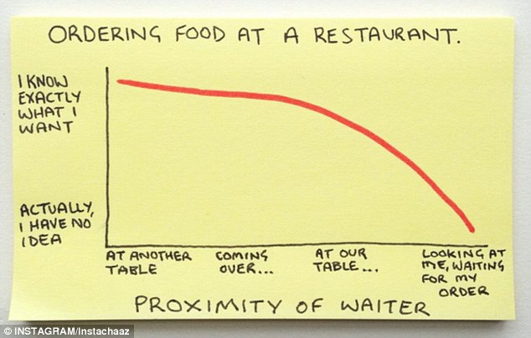
Telling Stories with Data

Slide 22
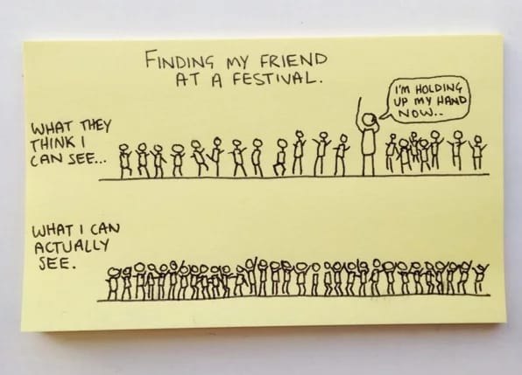
Telling Stories with Data

Slide 23
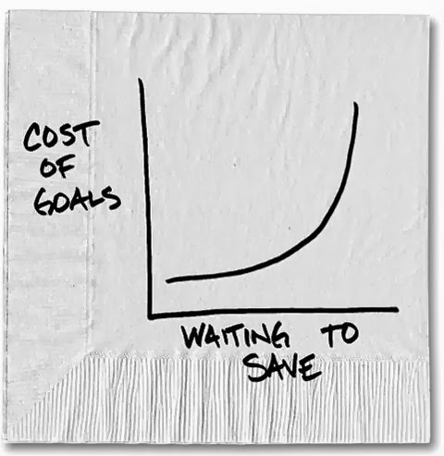
Telling Stories with Data
Carl Richards
of the New York Times

Slide 24
Breaking Down a Story
What’s Your Point?
Support Your Point.
Plot Twist!
Now What?
Notes:
What’s your point? – Call out the point in the title.
Support your point. – They spent the rest of the time supporting it.
Plot Twist. – Not only are they doing badly, only 6 students passed reading and math. Sometimes it’s the story. Sometimes it’s a data point.
Now What. – They followed up with a call to Action.

Slide 25
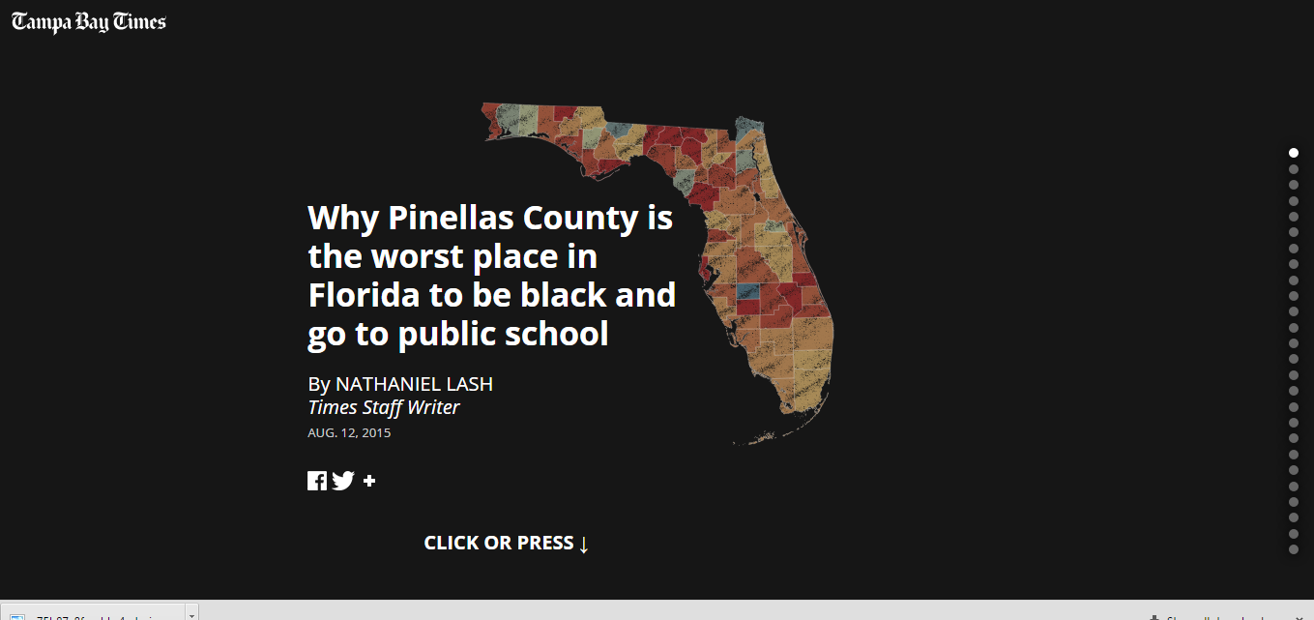
Let’s Start with An Example
Notes:
http://www.tampabay.com/projects/2015/investigations/pinellas-failure-factories/chart-failing-black-students/

Slide 26
What’s Your Point? Write it down. Seriously. Simply. Start with that.
“My Point Is…”
Notes:
Right off the bat, state the point. They didn’t say something bad is happening in Florida, right? They stated the point. “Pinellas County is the worst place in Florida to be black and go to public school.” You don’t have to create suspense with your audience by withholding the point you are trying to make. Instead use the point to draw in and engage your audience.
Think about how you can present it. Whether it is a slide, or the navigation button at the top of your dashboard.

Slide 27
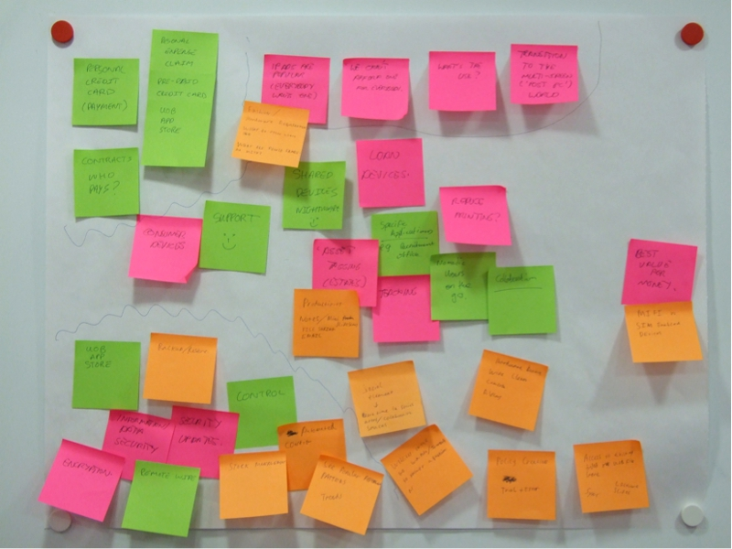
Support Your Point. The “maybe you’re a crazy person” post-it stratey!
Notes:
1. Write down any points, sub-points, and keywords on a bunch of post-it . Facts, themes, points…
2. Lay them all out
3. Play with until categories and themes emerge.
Allows you to put some structure around the chaos, so you can communicate the chaos to the audience effectively.

Slide 28
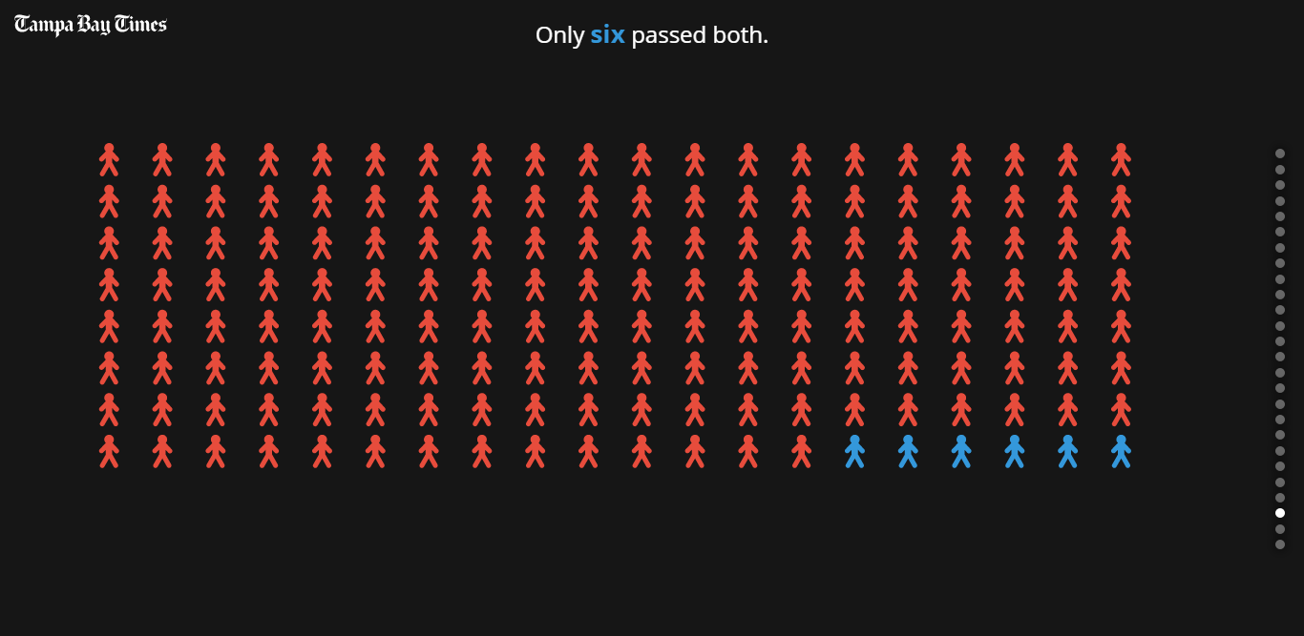
What’s Your Point
Notes:
Plot Twist.
The why can be your plot twist.
We can’t always have a crazy plot twist. It doesn’t have to be masterful, but could just be a Huh?!

Slide 29
Now What?
Take this opportunity to
make a recommendation.
Or at least to suggest next steps.
Notes:
Now What.
You’ve done all this work. You’ve convinced them on your analyst. You have a captive audience, so take advantage. Take this opportunity to make a recommendation. Or at least to suggest next steps.
Sometimes you don’t have all those pieces. You might not have the single point you want to make. Or you might not have the next steps. But if you think about this framework of four pieces, you can go to your colleagues to say. Look I have the support and I know the point, but I need help coming up with the recommendation.

Slide 30

Language Matters
Notes:
Language Matters
-
It’s a good idea to frame the language in your story to be less scary.
http://static1.businessinsider.com/image/553ff08eecad04b44fe189e0-1111-13216/the-landscape-of-office-jargon20150414.jpg

Slide 31

Audience Matters
Notes:
Your Audience. Matters, They are real live people.
Who is your audience? Are they technical? Executives? Experts? Novices? It’s not all about you. Its about the data and the insights and the audience you are communicating to.
Do you need to give any background or context?
You – Do you need to build your credibility?
History –
Assumptions
Metrics & Dimensions – Do you need to provide additional context?
It’s important to practice telling your story to an audience. To make sure as you’re explaining it, they are getting the same story you are trying to tell them.

Slide 32
Today’s Lesson: Story Structure for Visualizations Hands on Exercises Chart Types Advanced Chart Types Fit & Finish Homework Parameters (if there is time)

